Slide 1
Welcome Back – Part 7
Jerusalem Is Rebuilt
Ezra, Nehemiah, Esther, Haggai, Zechariah, Malachi

Slide 2
Captives Free to Return
536 BC
Many Israelites stayed where they were
  It has been almost 200 years since the first captives have been taken from Israel.
  722 BC
  The most recent captives have been gone 50 years
    They built homes and were content
    to stay
  It was their choice whether to return or not.
  Permission to go home included all the tribes of the Israelites. Ezra 1:3

Slide 3
Background of Haggai, Ezra, Nehemiah, Zechariah, and Malachi
Captivity
606 BC – First captives taken by Nebuchadnezzar.
Daniel 1:1-2
597 BC – Second Group (10,000) taken to Babylon.
2 Kings 24:10-16; Ezekiel 1:1-3
586 BC – Jerusalem falls, temple destroyed.
2 Kings 25:1-21
539 BC – Babylon falls to Medes and Persians.
Daniel 5: 25ff; Isaiah 44:27-45:1-4
Ecclesiastes 7:14 says, “In the day of prosperity be joyful, and in the day of adversity consider.”

Slide 4
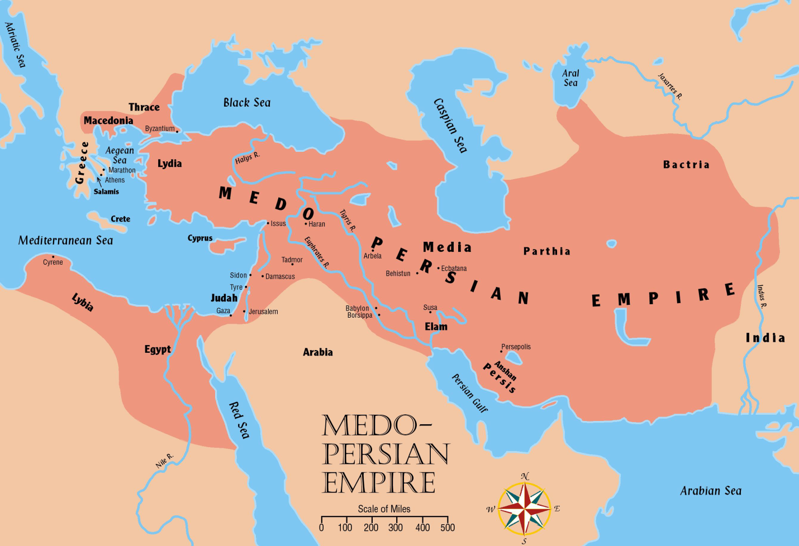
Jerusalem Is Rebuilt
Persia now controls all the territories once held by Assyrian and Babylonian empires

Slide 5
The People of Palestine
They profited from the Jews’ absence
  Adversaries: Samaritans, Ammonites, Edomites and Nomadic tribes moved into and nearer the fertile lands
  Samaritans desired to help build the temple. Ezra 4:1ff;Nehemiah 2:17ff;
  cf. 2 Kings 17:32.
  Jews accused of treason. Ezra 4:6ff; 11ff

Slide 6
The “three returns” in Ezra and Nehemiah and Background of Haggai and Nehemiah – Ezra 1-6
Restoration
536 BC – Cyrus issues a decree (538) for the Jews to go back to Jerusalem; after 70 years.
(cf. Jeremiah 25:11; 29:10-14)
  Almost 50,000 return under the leadership of Zerubbabel (2 Chronicles 36:21-23; Ezra 1; 2:64-65)
520-516 BC – The temple is completed.
Ezra 6:15; cf. Ezra 3:10ff; cf. Haggai 2:3
457 BC – Ezra led a second remnant of 2,058 Jews to Jerusalem. Ezra 8:1-34
444 BC – Nehemiah lead a third remnant back.
Nehemiah 2

Slide 7
Welcome Back
Esther – Takes place approximately between chapters 6 and 7 of the book of Ezra.
Haggai – “Consider Your Ways”
Nehemiah – A Man Of Action
Malachi – Would He Be Heard Today?

Slide 8
445-432 BC – Malachi writes about faithfulness to the Lord.
Restoration
About 100 years after the restoration.
2nd and 3rd generation descendants had begun to lose sight of serving the Lord and wholehearted zeal.
Worship was in decay, priests were careless regarding sacrifices. (1:6-8, 13; 2:9)
Tithing had been neglected. (3:9-10)
Indifference and skepticism characterized the nation as a whole. (3:14; 2:17)
Divorce and intermarriage with the Gentile women was common. (2:11-16)

Slide 9
Would Malachi Be Heard Today?
Part 2

Slide 10
Background of Haggai, Ezra, Nehemiah, Zechariah, and Malachi
Restoration
445-432 BC – Malachi writes about faithfulness to the Lord.
  About 100 years after the restoration.
  2nd and 3rd generation descendants had begun to lose sight of serving the Lord and wholehearted zeal.

Slide 11
Ye say … “Wherein hast thou loved us?” Malachi 1:2
Ye say … “Wherein have we despised thy name?” Malachi 1:6
Ye say … “Wherein have we polluted thee?” Malachi 1:7
Ye say … “Wherefore?” (Why is God displeased with us?) Malachi 2:10-14

Slide 12
Ye say … “Wherein have we wearied him?” Malachi 2:17
The Lord’s Answer:
Ye say, “Evil is good.” 2:17
Isaiah 5:20, “Woe unto them that call evil good, and good evil; that put darkness for light, and light for darkness; that put bitter for sweet, and sweet for bitter!”
Proverbs 17:15, “He that justifieth the wicked, and he that condemneth the righteous, Both of them alike are an abomination to Jehovah.”
Proverbs 14:34, “Righteousness exalteth a nation; But sin is a reproach to any people.”

Slide 13
Ye say … “Wherein have we wearied him?”
Malachi 2:17
The Lord’s Answer:
Ye say, “Where is the God of justice.” 2:17
  The evil charge against Jehovah is the opposite of His stated opposition to evil.
  (cf. Deuteronomy 18:19; 25:16)

Slide 14
Ye say… “Wherein have we wearied him?” Malachi 2:17
The Lord’s Answer:
Ye say, “Where is the God of justice?” 2:17
  God’s justice is coming. But first His messenger. 3:1-5.
    Malachi 3:1, “Behold, I send my messenger, and he shall prepare the way before me.”
    Isaiah 40:3-5; John 1:23
    This forward-looking vision arises in the midst of a nation that was tired of hearing prophetic messages.

Slide 15
Ye say… “Wherein have we wearied him?” Malachi 2:17
The Lord’s Answer:
Ye say, “Where is the God of justice?” 2:17
  God’s justice is coming. But first His messenger. 3:1-5.
    Malachi 3:1, “and the Lord, whom ye seek, will suddenly come to his temple; and the messenger of the covenant, whom ye desire, behold, he cometh, saith Jehovah of hosts.” (Isaiah 53; Romans 3:23-26;
    cf. Hebrews 8:8; 9:15; 10:5; 13:20)
    New refined priesthood. Hebrews 4:14ff; 7:26; 1 Peter 2:5, 9

Slide 16
Ye say… “Wherein have we wearied him?”
Malachi 2:17
The Lord’s Answer:
Ye say, “Where is the God of justice?” 2:17
  He will punish ALL the wicked and bless the faithful remnant. 3:6; 2 Peter 3:9
    Principle has always been true.
    Deuteronomy 30:1-10; Ezekiel 18:23;
    cf. Habakkuk 1:2-4; Psalms 74:1-14
    The reward for the righteous is “reserved in heaven” and “ready to be revealed in the last time” (1 Peter 1:4-5).

Slide 17
Ye say … “Wherein shall we return?”
Malachi 3:7
The Lord’s Answer:
“Keep my ordinances.” 3:7
  Days of Noah. Genesis 6:3; 1 Peter 3:20
  Moses warned. Deuteronomy 4, 8, 28-30
  Joshua warned. Joshua 23:14ff
You have not kept my ordinances.
cf. Nehemiah 13; Malachi 1-2;
Zechariah 1:3-4; cf. 2 John 9

Slide 18
Ye say … “Wherein have we robbed thee?” Malachi 3:8
The Lord’s Answer:
In tithes and offerings. 3:8;
cf. Leviticus 27:30-33
  God is not so destitute that He needs tithes and offerings to maintain Himself (Psalms 50:7-15).
“Prove me now …” 3:10-12;
1 Corinthians 16:1-3; 2 Corinthians 8-9
Psalms 37:25, “I have been young, and now am old; yet have I not seen the righteous forsaken, nor his seed begging bread.”

Slide 19
Ye say … “What have we spoken against thee?” Malachi 3:13-14
The Lord’s Answer:
Ye say: 3:14 NOTE: 1:7, 12-13; 2:17
  It is vain to serve God.
  What profit is it that we have kept His charge?
  We have walked mournfully.
  They tempt God, and escape.
Remnant: Distinction, makes a difference. 3:16ff; NOTE: Psalms 37:7-9;
cf. 2 Corinthians 4:16-18;
1 Corinthians 15:58; 2 Thessalonians 1:7-9

Slide 20
Conclusion:
  Remember the law of Moses.
  cf. Deuteronomy 4:1-9
  Elijah will come. cf. 3:1; Matthew 11:14; Mark 9:11-13; Luke 1:17

